Slide 1

NSG Pilkington – University of Liverpool Machine Learning Project: 07/10/2020
Dr. Peter Green
Diego Echeverria
Risk Institute,
School of Engineering

Slide 2
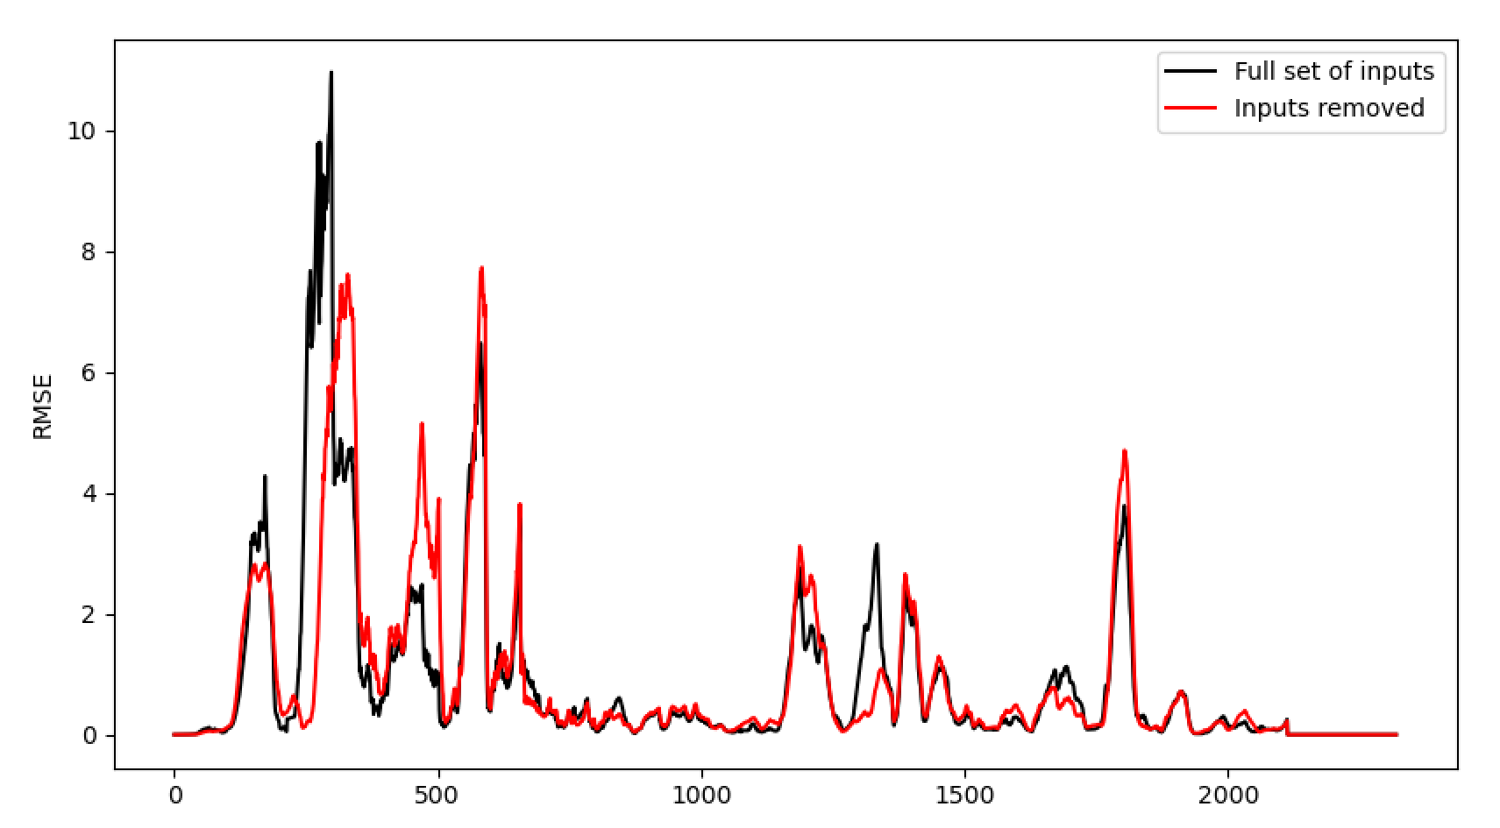
Summary of last week’s results

Slide 3
Inputs that were retained:
10278 Canal Temp. Control (OP)
10279 Canal Temp. Control (PV)
10425 Calculated Cullet Ratio
11105 Port 1 Combustion Air Flow LHS (OP)
11111 Port 2 - 3 Combustion Air Flow LHS (OP)
11123 Port 6 - 7 Combustion Air Flow LHS (OP)
11126 Port 6 - 7 Combustion Air Flow RHS (OP))
11132 Port 8 Combustion Air Flow RHS (OP)
11174 Furnace Bottom Temperature 18m D/S of B8
11209 MV49
11217 Services Building MCC9 Cat 'B' Supply - MV60
11384 Wobbe Index (Incoming Gas)
1650 Combustion Air Temperature Measurement
1950 Canal Temp. Control Pyrometer (2)
239 Working End Burner Gas Flow RHS (PV)
2911 Filling Pocket Closed Bottom Temperature LHS (PV)
2918 Closed Bottom Temperature - Port 6 (PV)
2921 Closed Bottom Temperature - Upstream Working End (PV)
30208 Feeder Speed Measurement Left
6472 Front Wall Temperature 7
7483 Open Crown Temperature - Port 6 (PV)
7522 Open Crown Temperature - Port 4 (PV)
7525 Open Crown Temperature - Port 7 (PV)
7667 Port 7 Gas Flow (PV)
9282 Tweel Position
9393 Glass Level Control (OP)
9395 Main Gas Pressure (OP)
9397 Port 3 Gas Flow (OP)
9399 Port 2 Gas Flow (OP)
9403 Furnace Pressure (OP)

Slide 4
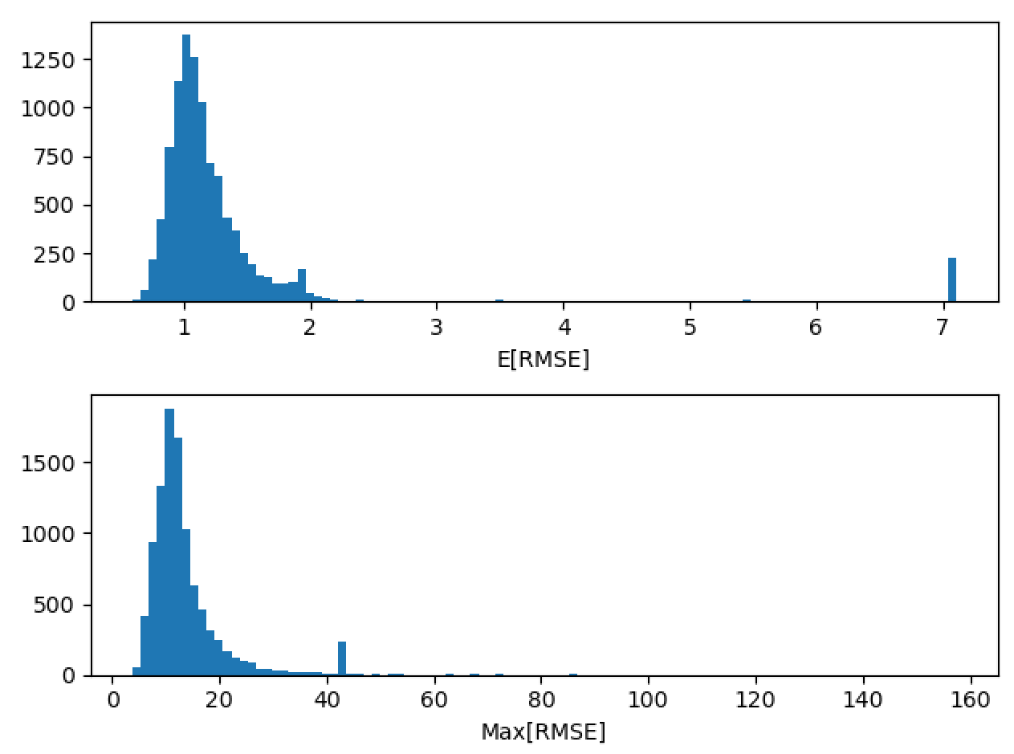
Randomly selecting the best inputs
Lowest average RMSE = 0.595
Lowest max RMSE = 3.801

Slide 5
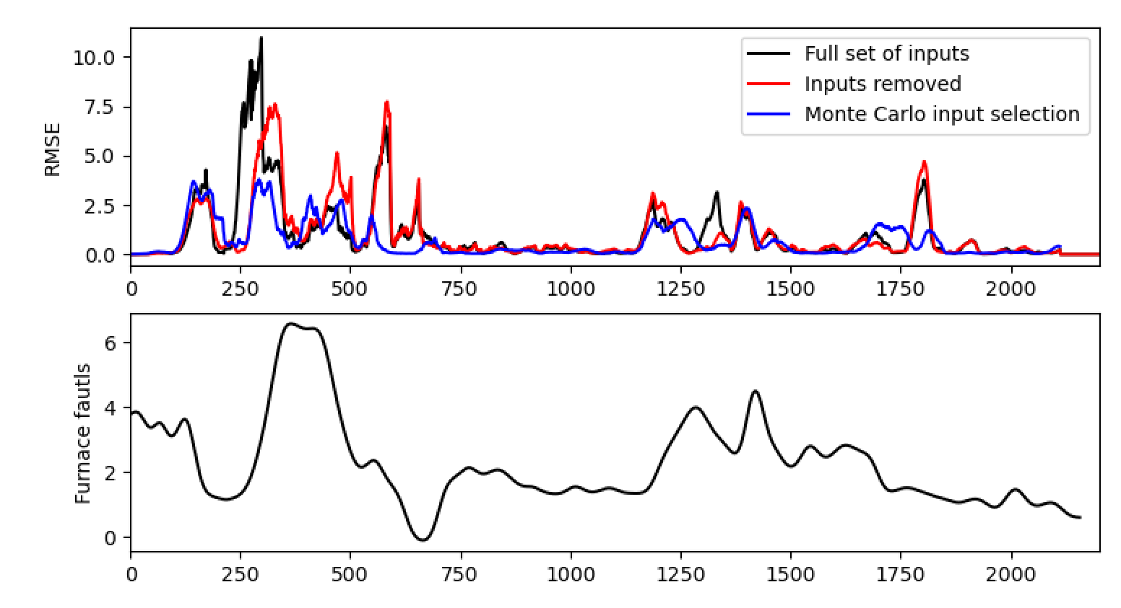
Randomly selecting the best inputs
Some improvement, but still lacks some predictive capability in the key areas.
(Note video now includes plot of load…)

Slide 6
Inputs that were retained:
11111 Port 2 - 3 Combustion Air Flow LHS (OP)
10425 Calculated Cullet Ratio
2918 Closed Bottom Temperature - Port 6 (PV)
10278 Canal Temp. Control (OP)' '9397 Port 3 Gas Flow (OP)
7434 Cooling Water Flow - Furnace LHS
7522 Open Crown Temperature - Port 4 (PV)
136 Total Combustion Air Flow Measurement
7483 Open Crown Temperature - Port 6 (PV)

Slide 7
Auto-regressive approach (1)
Max lag
An auto-regressive model also includes previously observed furnace faults as an input
Fault
Density
Time
Min lag
Tag 1
Time
Tag 2
Time

Slide 8
Auto-regressive approach (1)
Max lag
Fault
Density
Time
Min lag
Tag 1
Time
Tag 2
Time

Slide 9
Auto-regressive approach (1)
Max lag
Fault
Density
Time
Min lag
Tag 1
Time
Tag 2
Time

Slide 10
Auto-regressive approach (1)
Max lag
Fault
Density
Time
Min lag
Tag 1
Time
Tag 2
Time

Slide 11
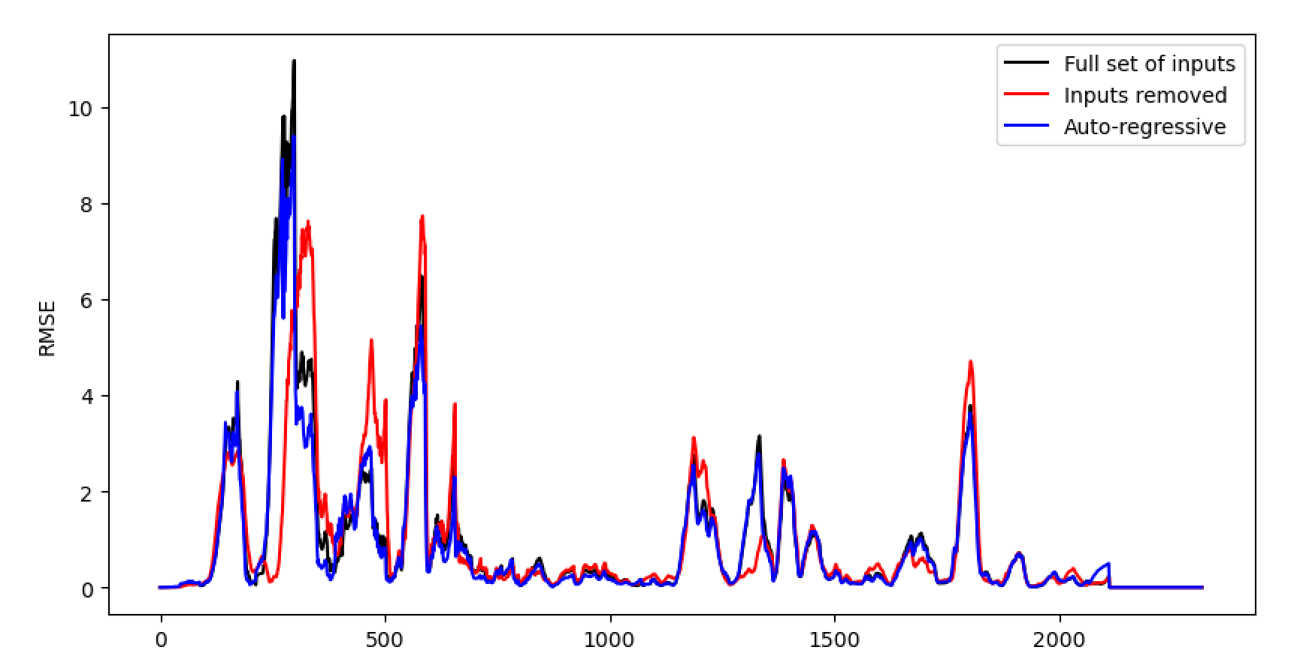
Auto-regressive approach (1)

Slide 12
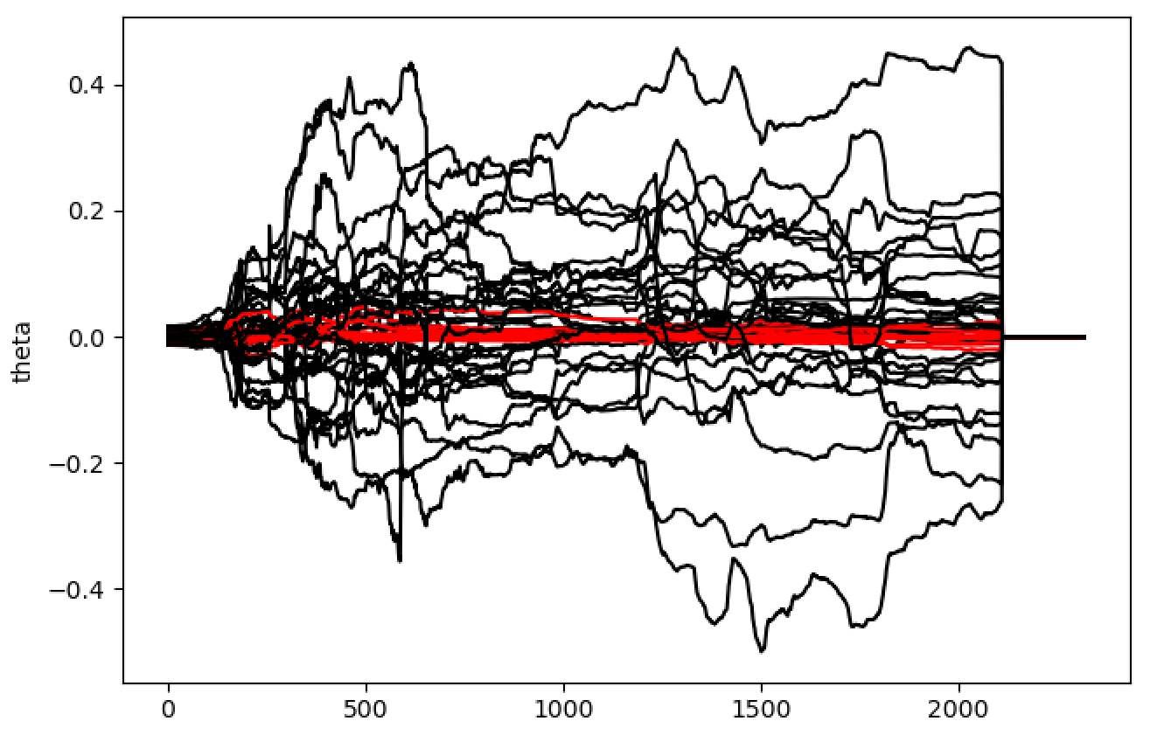
Auto-regressive approach (1)
To retain:
11201 Furnace & Services Pack Sub S8 L.H. Section - HV13
11204 Furnace & Services Pack Sub S8 R.H. Section - HV16
135 Total Firm Gas Flow Measurement
136 Total Combustion Air Flow Measurement
15119 Furnace Pressure (PV)
30060 U/S Flowing End Air Flow Measurement
6310 Cooling Water Flow - Furnace RHS
6400 Furnace Compressed Air Flow Measurement
6463 Main Gas Pressure (PV)
6469 Furnace Pressure Meas. on Crown
6585 Port 6 Gas Flow (PV)
7434 Cooling Water Flow - Furnace LHS
7474 Lehr Drive Line Shaft Speed
7667 Port 7 Gas Flow (PV)
7746 Open Crown Temperature - Port 2 (PV)
8344 Total CCCW Flow Measurement

Slide 13
Auto-regressive approach (2)
Max lag
Fault
Density
Time
Min lag
Tag 1
Time
Tag 2
Time

Slide 14
Auto-regressive approach (2)
Max lag
Fault
Density
Time
Min lag
Tag 1
Time
Tag 2
Time

Slide 15
Auto-regressive approach (2)
Note that the model’s predictions are now conditional on its previous predictions, rather than previously measured values
Max lag
Fault
Density
Time
Min lag
Tag 1
Time
Tag 2
Time

Slide 16
Auto-regressive approach (2)
Note that the model’s predictions are now conditional on its previous predictions, rather than previously measured values
Max lag
Fault
Density
Time
Min lag
Tag 1
Time
Tag 2
Time

Slide 17
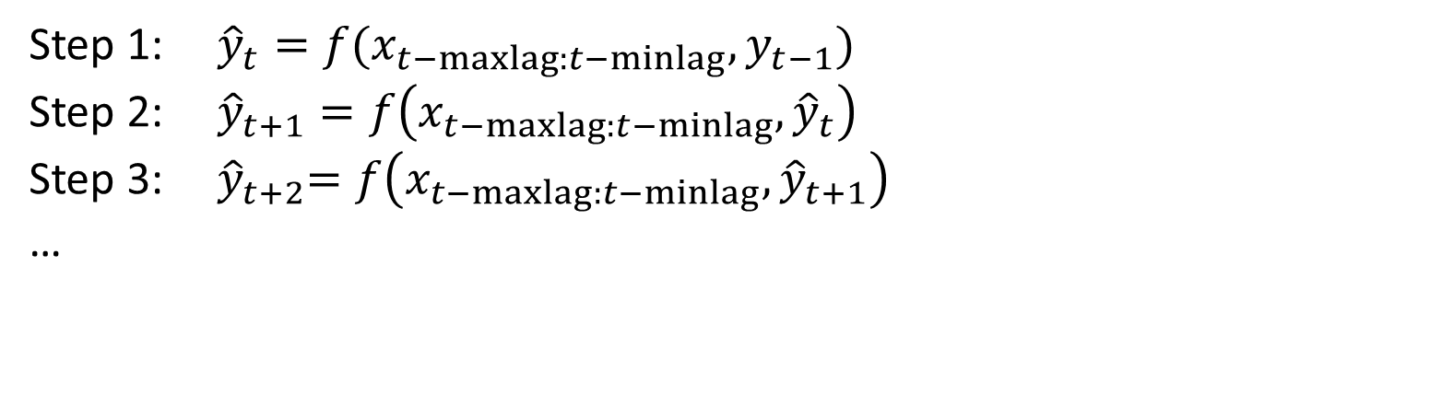
Auto-regressive approach (2)
Step 1: ${\hat{y}}_{t}=f(x_{t−maxlag:t−minlag}, y_{t−1})$
Step 2: ${\hat{y}}_{t+1}=f\left(x_{t−maxlag:t−minlag},{\hat{y}}_{t}\right)$
Step 3: ${ \hat{y}}_{t+2}=f\left(x_{t−maxlag:t−minlag},{\hat{y}}_{t+1}\right)$
…

Slide 18
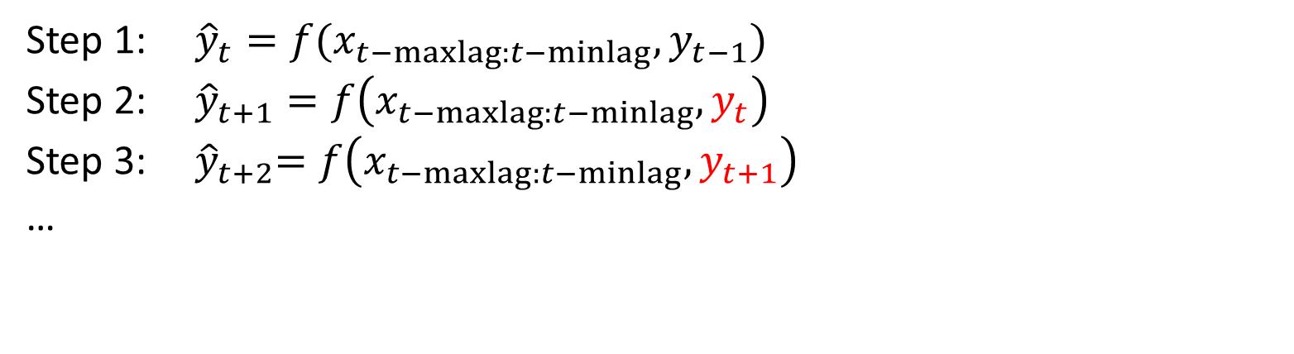
Auto-regressive approach (2)
Actually, we can cheat to see what baseline performance this type of model can achieve.
Step 1: ${\hat{y}}_{t}=f(x_{t−maxlag:t−minlag}, y_{t−1})$
Step 2: ${\hat{y}}_{t+1}=f\left(x_{t−maxlag:t−minlag},y_{t}\right)$
Step 3: ${ \hat{y}}_{t+2}=f\left(x_{t−maxlag:t−minlag},y_{t+1}\right)$
…

Slide 19
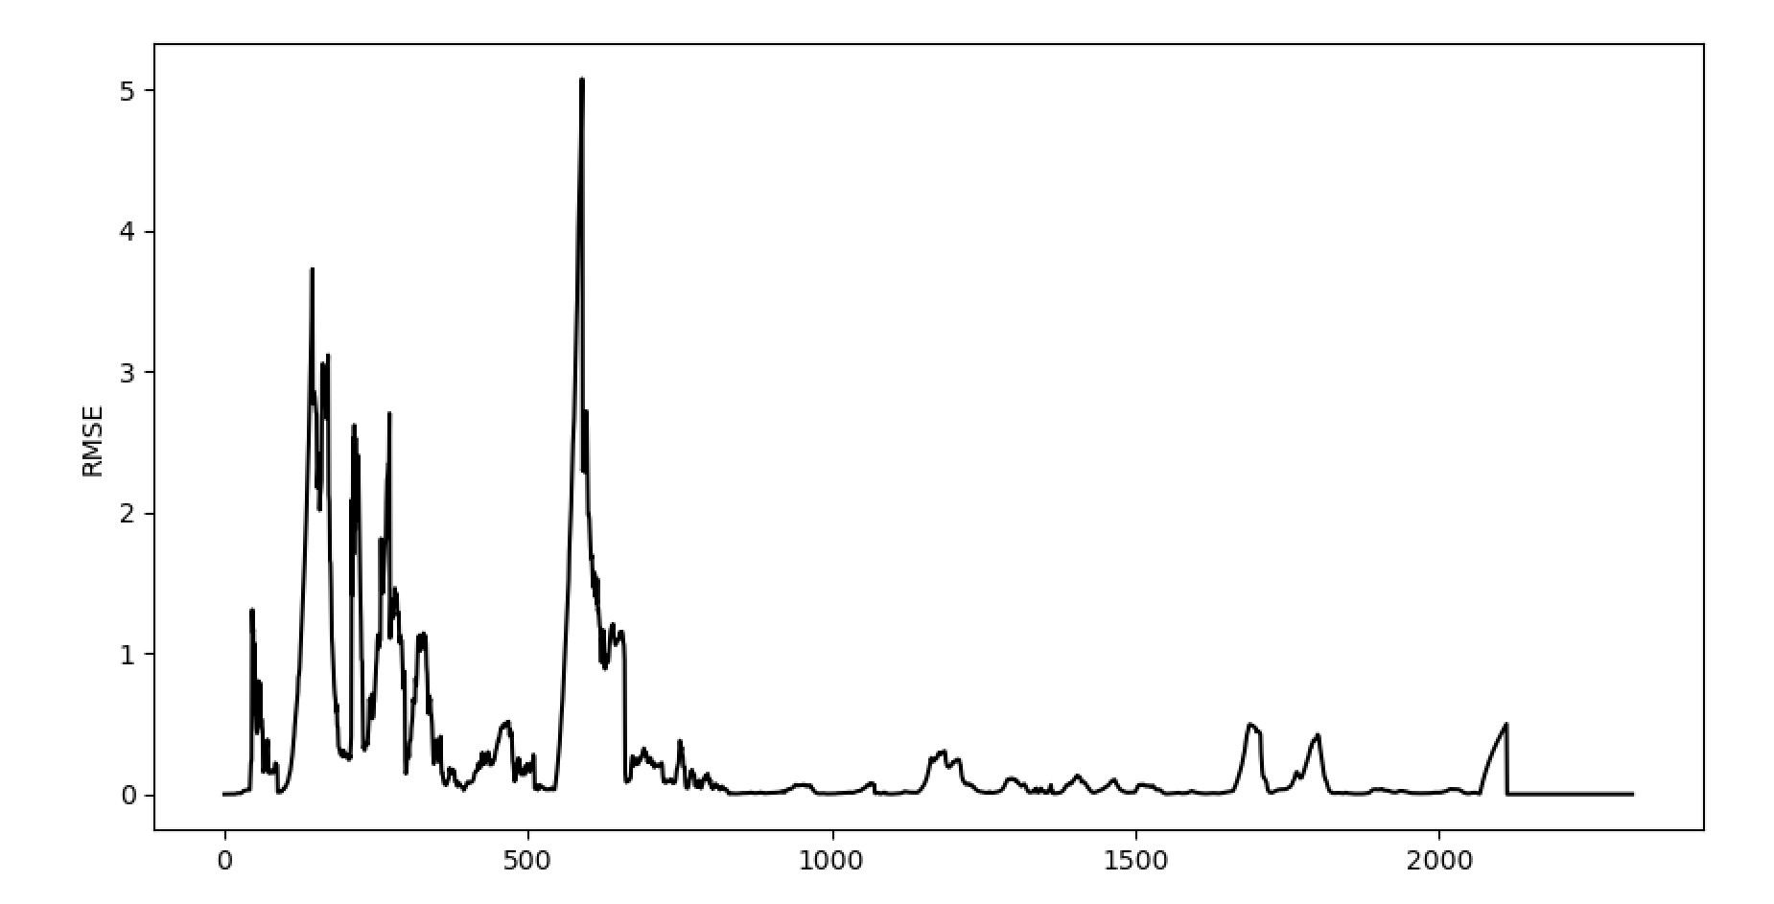
Auto-regressive approach (2)

Slide 20
Auto-regressive approach (2)
Perhaps we shouldn’t be looking to improve the model in this region (still learning etc.)
But we should look to improve performance here

Slide 21
Next Steps
AR model (1) with reduced inputs
AR model (2)
Filtering (still ongoing)
Re-run randomly selected inputs, focusing on 2nd half of data
Can now investigate nonlinear model structures

Slide 22
Thank you for your attention. ANY QUESTIONS?

